Slide 1
R. Johnsonbaugh
Discrete Mathematics
5th edition, 2001
Chapter 10
Automata, Grammars
and Languages

Slide 2

10.1 Sequential circuits and finite-state machines
Unit-time delay
A unit time delay accepts as input a bit x _{t} at
time t and outputs x _{t -1}, the bit received as
input at time t -1. It is used in the serial adder.

Slide 3
Serial adder
A serial adder accepts as input two binary numbers x and y and outputs the sum z = x + y
x = 0x_{N}x_{N-1}…x₁x₀
y = 0y_{N}y_{N-1}…y₁y₀
z = z_{N+1}z_{N}z_{N-1}…z₁z₀
x and y are input sequentially in pairs
x₀,y₀; x₁,y₁; …; 0,0
The sum is the output z₀, z₁,…, z_{N}, z _{N+1}

Slide 4
Example of a serial adder
A serial adder circuit performs addition in the binary system
Example: add x + y,
where x = 010 and y = 011
  x₀ = 0, y₀ = 1.
  Adding these two, obtain z₀ = 1 and i = 0
  x₁ = 1, y₁ = 1.
  Adding these two, obtain z₁ = 0 and i = 1
  x₂ = 0, y₂ = 0.
  Add these two plus the last i =1 and obtain z₂ = 1
Final answer is
z = 101

Slide 5
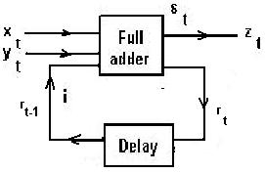
Serial adder circuit

Slide 6
Finite-state machines
A finite-state machine M = (I, O, S, f, g, σ), where:
a) I is a finite set of input symbols
b) O is finite set of output symbols
c) S is a finite set of states
d) f: S x I → S is a next-state function
e) g: S x I → O is an output function
f) σ is an initial state

Slide 7
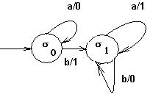
Example of a finite-state machine
Input symbols→ |  | f |  | g
 |  | a | b | a | b
States | σ₀ | σ₀ | σ₁ | 0 | 1
 | σ₁ | σ₁ | σ₁ | 1 | 0
I = {a, b}
O = {0, 1}
S = {σ₀, σ₁}
f and g are defined by the table and the transition diagram

Slide 8
Input and output strings
Given a finite state machine M = (I, O, S, f, g,σ), an input string for M is a finite sequence α = x₁x₂…x_{n} over I, i.e. x_{j} ∈ I for 1 < j < n.
Given an input string α = x₁x₂…x_{n}, then
β = y₁y₂…y_{n} is an output string for M if
  there exist states σ₀ = σ, σ_{i} = f(σ_{i-1},x_{i}) for i = 1,…, n
  and y_{i} = g(σ_{i-1},x_{i}) for i = 1,…, n.

Slide 9
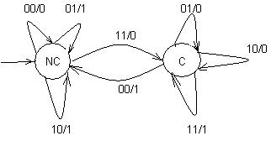
A serial adder finite-state machine
A serial adder accepts pairs of bits, thus its input set is {00, 01, 10, 11}
And the output set is the set {0, 1}
Two states: NC (no carry) and C (carry)
Initial state NC

Slide 10
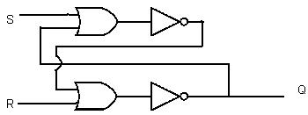
SR flip-flop (1)
Set-reset flip-flop
S | R | Q
1 | 1 | Not allowed
1 | 0 | 1
0 | 1 | 0
0 | 0 | 1 if S was last 1 0 if R was last 1
Sequential circuit implementation
of the SR flip-flop

Slide 11
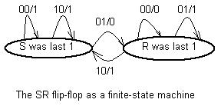
SR flip-flop (2)

Slide 12
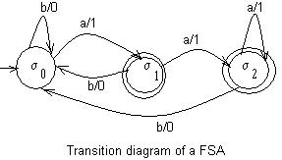
10.2 Finite state automata
A finite-state automaton
is a special kind of finite
state machine.
A = (I, O, S, f, g, σ) with output set O = {0, 1} and the current state determines the next state.
States for which the last output is 1 are called accepting states.
Example of a FSA
Input symbols→ |  | f |  | g
 |  | a | b | a | b
States | σ₀ | σ₁ | σ₀ | 1 | 0
 | σ₁ | σ₂ | σ₀ | 1 | 0
 | σ₂ | σ₂ | σ₁ | 1 | 0

Slide 13
Alternative definition of a FSA
A finite-state automaton A is
I = set of input symbols
S = set of states
f :S x I → S, next-state function
A ⊆ S, a set of accepting states
σ = initial state
Write A = (I, S, f, A , σ)

Slide 14
Accepted strings
α = x₁x₂…x_{n} is an accepted string over I
if there are states σ₀, σ₁,…, σ_{n} satisfying
a) σ₀ = σ
b) f(σ_{i-1},x_{i}) = σ_{i}, for i = 1,…, n
c) σ_{n} ∈ A

Slide 15
Examples of accepted strings
Some of the strings accepted by the FSA in the diagram are: a, a^{n} (n >1), aba^{k} (k > 1), (ab)^{m}a^{k} (k >1), etc.
Let Ac(A) = {accepted strings of A}
Strings ending in b are not accepted

Slide 16
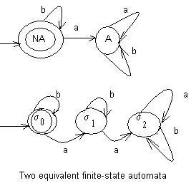
Equivalent finite-state automata
Two FSA's A and A' are
equivalent if they accept
exactly the same strings
i.e. Ac(A) = Ac(A' )

Slide 17
Languages and Grammars
Let A be a finite set.
Define A* = { all strings over A }
A grammar G consists of:
a) a finite set N of nonterminal symbols
b) a finite set T of terminal symbols
c) a finite set P of productions, where
P ⊆ [(N ∪ T)* - T*] x (N ∪ T)*
d) a starting symbol σ

Slide 18
Formal languages
A (formal) language over A is a subset L ⊆ A*
  Example: A = {a, b}
  A* = { all strings using letters a and b}
  L = { α | α is a string ending in b} ⊆ A*

Slide 19
Productions
A production (A,B) ∈ P can be written A → B where A ∈ (N ∪ T)* - T* and B ∈ (N ∪ T)*
If α → β is a production and xαy ∈ (N∪T)* then we say that xβy is directly derivable from xαy and we write xαy ⇒ xβy

Slide 20
Language generated by a grammar
The language L(G) generated by G consists of all strings over T derivable from σ.
  If grammars G and G' generate the same languages, i.e. L(G) = L(G'), then G and G' are equivalent.

Slide 21
Backus-Naur (BNF) form
Nonterminal symbols are written <…>
Production S → T is written S:: =T
Productions of the form
S:: = T₁, S:: = T₂,…, S:: = T_{n}
can be written
S:: = T₁| T₂|…| T_{n}

Slide 22
Backus-Naur (BNF) form
Example: A grammar for integers. Productions:
<digit>:: = 0|1|2|3|4|5|6|7|8|9
<integer>:: = <signed integer>|<unsigned integer>
<signed integer> :: = +<unsigned integer>|<unsigned integer>
<unsigned integer> :: = <digit>|<digit><unsigned integer>
Starting symbol is <integer>

Slide 23
Types of grammars
Context-sensitive (type 1)
  Every production is of the form αMβ → αQβ, where α, β∈ (N ∪T)*, M ∈ N, Q ∈ (N ∪ T)* - {λ}, where λ is the null string.
Context-free (type 2)
  Every production is of the form A → K, where A ∈ N, K ∈ (N ∪ T)*
Regular (type 3)
  Every production is of the type A → a or A → aB or A → λ, where A, B ∈ N, a ∈ T.

Slide 24
Lindenmayer grammar
A Lindenmayer context-free (LCF) grammar consists of:
a) a finite set N of nonterminal symbols
b) a finite set T of terminal symbols, with N ∩ T = ∅
c) A finite set P of productions A → B, where A ∈ N ∪T, B ∈ (N ∪ T)*
d) a starting symbol σ
  Notice that in this LCF grammar A can be terminal or nonterminal.

Slide 25
Von Koch Snowflake (1)
This is a LCF grammar G with
N = {D}
T = {d, +, -}
P has four productions:
  D → D – D + + D - D
  D → d
  + → +
  - → -
A derivation is D ⇒ D – D + + D – D ⇒ d – d + + d – d
  Therefore d – d + + d – d ∈ L(G)

Slide 26
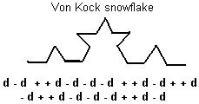
Von Koch Snowflake (2)
This grammar produces Von Koch snowflakes, which are an example of fractal curves.

Slide 27
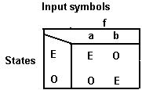
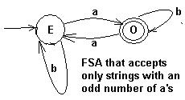
10.4 Nondeterministic FSA
A finite-state automaton may be converted to a regular grammar in the following way:
Example: Let A = (I, S, f, A, E) be a FSA with
I = {a, b}, S = {E, O}, A = {O} and f defined by the following table and transition diagram

Slide 28
A grammar defined by a FSA
Let N = S = {E, O}, T = I = {a, b}
Let σ = E (starting symbol)
Productions P = the directed edges
For every edge x between S and S', define a production S → xS'. In this case we have the productions E → bE, E → aO, O → aE and O → bO
Add the production S → λ whenever S is an accepting state. In our case, we add O → λ

Slide 29
Accepted strings and language
Theorem 10.4.2: Let A be a finite-state
automaton given as a transition diagram with initial state σ, N = {states} and T = {input symbols}.
Let P = set of productions S → xS' whenever there is a directed edge x = (S, S'), and S → λ.
Let G = (N, T, P, σ) be a regular grammar.
Then the set Ac(A) of strings accepted by A is equal to L(G).

Slide 30
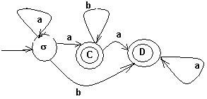
Nondeterministic FSA
A nondeterministic finite-state automaton is characterized for having more than one label x in some of its vertices and, therefore, given input x, there is room for choice of next state.

Slide 31
Table of a nondeterministic FSA
Start with I = {a, b}, S = {σ, C, D}, Accepting states = {C, D}
Next state function | f | f
States | a | b
σ | {σ, C} | {D}
C | ∅ | {C}
D | {C, D} | ∅

Slide 32
10.5 Languages and automata
Given a finite-state automaton A there exists a grammar G such that L(G) = Ac(A).
Conversely, if G is a regular grammar, there exists a nondeterministic finite-state automaton A such that L(G) = Ac(A).

Slide 33
Regular grammars and FSA
Also, given a nondeterministic FSA A there exists a deterministic FSA A' equivalent to A.
Therefore, if G is a regular grammar, there exists a deterministic finite state automaton A with L(G) = Ac(A).

Slide 34
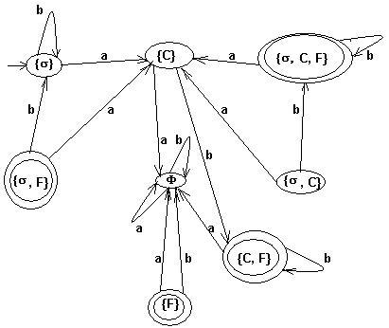
Transition diagram of a nondeterministic FSA

Slide 35
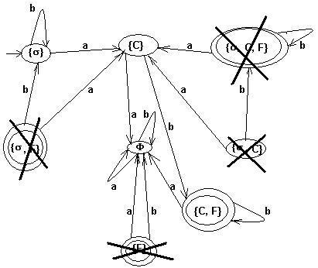
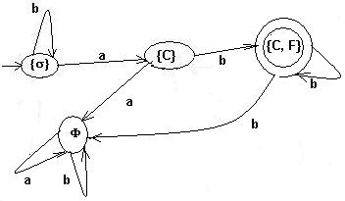
Unreachable states
When unreachable states are deleted, the previous diagram is simplified:

Slide 36
A deterministic FSA equivalent to a nondeterministic FSA
Theorem 10.5.3: Let A = (I, S, f, A, σ) be a nondeterministic finite-state automaton. Let
S' = P(S)
I' = I
σ' = σ
A' = { X ⊆ S | X ∩ A ≠∅}
f '(X,x) = ∅ if X = ∅ OR ∪ f(S,x) if X≠∅
^{S ∈ X}
Then the finite-state automaton A' = (I', S', f', A', σ') is equivalent to A.

Slide 37
Regular grammars and languages
Theorem 10.5.4: A language L is regular if and only if there exists a finite-state automaton that accepts precisely the strings in L.
Example: a language L that is not regular:
L = {a^{n}b^{n} | n = 1, 2, 3,…}

Slide 38
Reverse of a language
The reverse L^{R} of a language L is defined as the
set
L^{R} = {x_{n}x_{n-1}…x₂x₁ | x₁x₂…x_{n} ∈ L}
Example: if ab²ab ∈ L, then bab²a ∈ L^{R}.

Slide 39
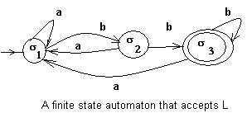
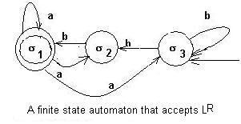
Example of L and L^{R}

